Slide 1
Quality Requirements Elicitation Based on Inquiry of Quality-Impact Relationships
Farnaz Fotrousi , Samuel A. Fricker and Markus Fiedle
Blekinge Institute of Technology
Presented by Eshaan Jain

Slide 2
Problem Statement
Quality Requirements (Non functional requirements) are difficult to elicit
Challenging to decide the good-enough quality of the requirements
Meeting the right level of quality is important to balance both the benefits and the cost
Impact of the problem-
1. Too low quality leads to disappointment for the stakeholders and they may decide to abandon the software
2. Excessive quality is costly and Inefficient which may cause trade-offs for other quality attributes

Slide 3
Proposed Solution
Proposes to elicit the specific relationships between software quality levels and their impacts for given quality attributes and stakeholders
This paper describes an approach to elicit such quality–impact relationships and to use them for specifying quality requirements
Develop Service Level Agreements (SLA) that allow reuse of the quality requirements
Key Terms— Requirement elicitation, quality attributes,
non-functional requirements, quality of service (QoS), quality
of experience (QoE)

Slide 4
Key Terms
Non Functional Requirements - specifies criteria that can be used to judge the operation of a system, rather than specific behaviors
Quality Attributes - factors that affect performance, run-time behavior, system design, and user experience
Quality of Service (QoS) – The degree to which the system satisfies the needs of its stakeholders. It tells whether a system exhibits the desired quality characteristics
Quality of Experience (QoE) - The degree of delight or annoyance of the user of an application or service. User satisfaction is expressed as Quality of Experience.
Quality of Service (QoS) affects the user’s Quality of experience (QoE)
Service Level Agreements (SLA) - contract between a service provider and the end user that defines the level of service expected from the service provider

Slide 5
Content
Section I : Introduction
Section II : Existing Work
Section III : Quality-Impact Inquiry method & Real World Example
Section IV: Conclusion

Slide 6
INTRODUCTION

Slide 7
Introduction
Quality requirements are an important class of nonfunctional requirements
The satisfaction of these quality attributes determines whether the software system meets the goals of its stakeholders or whether the system has a negative impact for these stakeholders
We will empirically develop quality-impact relationship by Quality of Service (QoS) and Quality of Experience (QoE)
Example | QUALITY | IMPACT
POSITIVE | Response Time : 0.1 second | user thinks the software is excellent
NEGATIVE | Response Time : 10 second | user thinks the software is bad

Slide 8
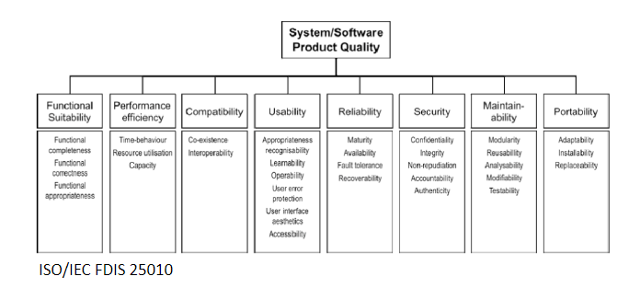
Quality Requirements

Slide 9
EXISTING WORK

Slide 10
Existing Work
GOAL models – They allow identification of needs for improving, increasing, or keeping the level of the quality characteristics of a software and help elicit quality requirements
Supporting Elicitation Methods - questionnaires, interviews, workshops, creativity methods, storyboards, use cases, role-plays, and prototyping
Review of prototypes has been effective to reach user acceptance
The supporting elicitation methods provide limited support for the determination of good-enough quality levels because of their generality

Slide 11
Existing Work
Limitations of Goal Models
Goal models are of limited help eliciting appropriate levels of quality
Goal models do not relate a given quality level to a given level of impact
Goal models do not deliver the information needed to quantify a quality requirement

Slide 12
Existing Work
Problems
The knowledge of how QoS is related to QoE has not been translated into requirements engineering methodology yet
It is unclear how to exploit the relationship between QoS levels with QoE levels in the requirements
How to apply the specifics of the QoS-QoE relationship on the determination of good-enough quality

Slide 13
QUALITY-IMPACT Inquiry
and
REAL WORLD EXAMPLE

Slide 14
Quality-Impact Inquiry
This method addresses the so far unsatisfactorily solved problem of determining adequate levels of quality
Based on the principles about the generic relationships between Quality of Service (QoS) and Quality of Experience(QoE)
These principles are integrated it into an inquiry-based requirements analysis process and combined with prototyping, questionnaires, and workshops as supporting methods for collection of quality measurements and stakeholder opinions

Slide 15
Quality-Impact Inquiry Process (1/3)
A. Inquiry Process
1. Preparation
2. Measurement
3. Analysis
4. Decision-Making
B. Method Tailoring

Slide 16
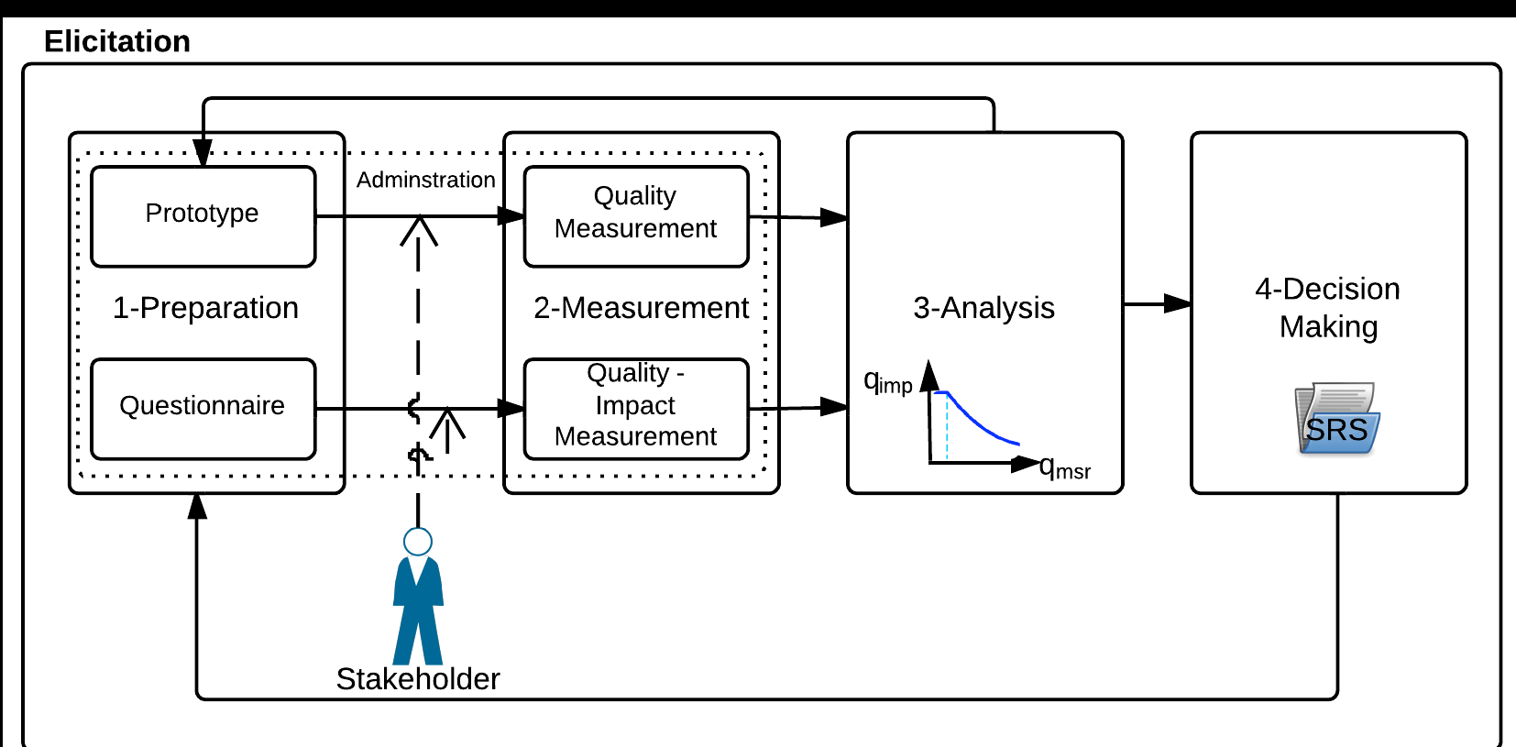
Quality-Impact Inquiry Process (2/3)

Slide 17
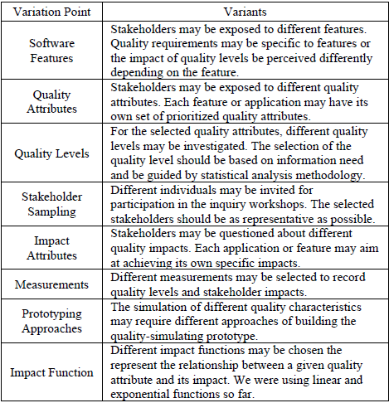
Quality-Impact Inquiry Process (3/3)
B. Method Tailoring

Slide 18
Diabetes Smartphone Application
Used by diabetes patients to take blood glucose measurements, to plan insulin injection, and to send the medical records to the diabetes specialist for consultation
We evaluated the quality-impact relationships for the following features- :
1. User Authentication
2. Sharing of Information with the Doctors
Prototype – software application for monitoring the timing of user interactions and with preloaded data
The requirements engineer, the product manager, and end-users participated in the inquiry workshop. The inquiry was performed with one end user at the time

Slide 19

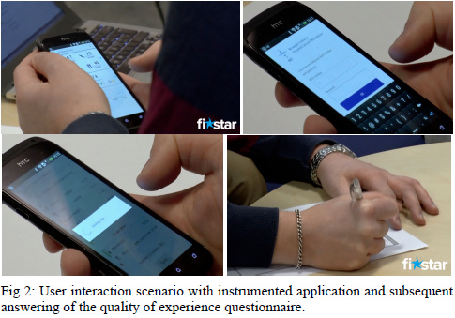



Diabetes Smartphone Application
End User used the selected features
first according to instructions and
then without help
User opened the application,
authenticated himself by providing
username and password, selected
the data to be shared with clinician
and submitted the data
Quality of experience (QoE)
questionnaire after the guided and
unguided experience

Slide 20
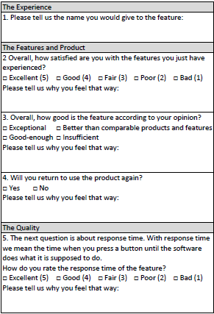
Quality-Impact Inquiry process for Diabetes Smartphone Application
Preparation
Preparation of prototype,
questionnaire, recruiting stakeholders
Instructions/Manual to assist the
end-user to use the application
Non-functional requirement:
Response time (attribute) should be
less than 2 seconds (value)
Quality of experience (QoE)
questionnaire with generic questions
about the features, product,
user-experience and the quality

Slide 21

Quality-Impact Inquiry process for Diabetes Smartphone Application
Measurements
PM explains the feature to
be used to the end-user in workshop
The end-user uses the
application twice
User interaction is captured in logs
The user answers the QoE
questionnaire
The answers are used for
calculating the quality-impact
relationship
WORKSHOP

Slide 22
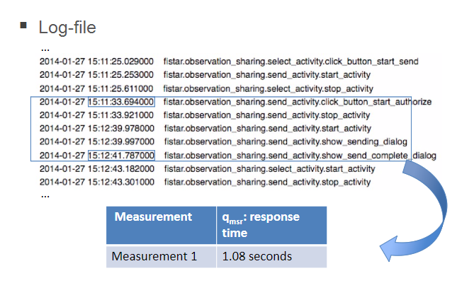
Quality-Impact Inquiry process for Diabetes Smartphone Application
Success Measure – Higher value of quality attribute (availability) – Better Quality
Failure Measure – Higher value of quality attribute (response time) – Worst Quality

Slide 23
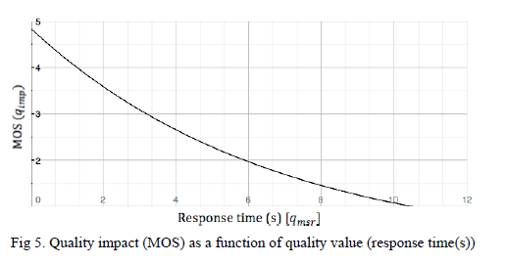
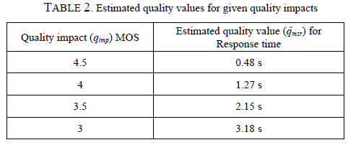
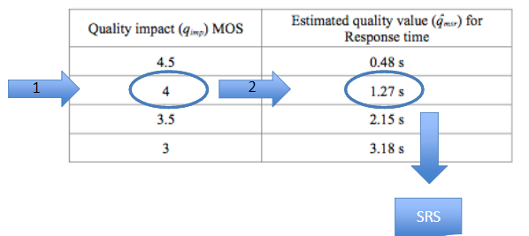
Quality-Impact Inquiry process for Diabetes Smartphone Application
Analysis
Filled-in questionnaires and
time-stamp logs from all end-users
interactions were used for analysis
Response time & quality impacts
collected from different
experiments
Shorter response identifies
the better perception of quality
and user’s score
Change in prototype if data is not
enough for analysis

Slide 24
Quality-Impact Inquiry process for Diabetes Smartphone Application
4. Decision-Making
The analysis results are used to decide about acceptable and desired levels of quality of the quality attributes
The decisions are recorded in the software requirements specification
The correlation between quality measurement and stakeholder’s opinion is analyzed and used as decision-support to determine good-enough requirements quality
This process identifies quality impact considering technical feasibility, product strategies, and limitation of resources to achieve the relevant quality value

Slide 25
CONCLUSIONS

Slide 26
Conclusions and Future Work
Good-Enough software quality can be determined by using Quality-Impact Inquiry method
Future work aims at validating and evaluating the method for large scale requirement engineering
Expand the understanding of the generic relationships between quality attributes and their impacts
Simplifying Quality-Impact Inquiry in real world projects

Slide 27
My Critique
Paper proposes a generic approach to determine Quality-Impact relationship between the requirements and the customer satisfaction
Generic relationship between QoS and QoE reduce the need for experimentation during real world Requirement Elicitation
Four Step process is independent of the specific type of quality and any specific type of stakeholder
Quality requirements, if determined and measured properly by this method will greatly enhance the overall performance of the system
Other factors such as competitors, product strategic decisions and technology could be a hindrance to decide good-enough quality

Slide 28
SLA Status Table
Severity | Response Time | Resolution Time
Severity 1 | 30 minutes | 1 hour
Severity 2 | 1 hour | 2 hours
Severity 3 | 2 hours | 8 hours
Severity 4 | 1 day | 10 days
 | SLA status
Resolved in Month – December 2015
Severity | Total Resolved | SLA passed | SLA missed | % SLA met
1 | 0 | 0 | 0 | NA
2 | 0 | 0 | 0 | NA
3 | 347 | 340 | 7 | 97.98%
4 | 286 | 281 | 5 | 98.25%

Slide 29
Strengths of Paper
Addresses challenges and methods to determine good-enough quality requirements
QoE questionnaires might propose new functional requirements while checking Quality-Impact relationship
User training is done to mitigate the biasing of user perception due to misuse of the quality feature
Reuse of the Quality-Impact relationships in the form of Service Level Agreements (SLA)
Enhances customer satisfaction if required quality is provided by the software

Slide 30
Weakness of the Paper
Generic method for Quality-Impact Relationship – doesn’t fit to all projects/software models
Prolonged usage of the application should be planned to quantify the quality of requirements
Some quality attributes are relevant in some contexts only
No standard criteria explained to decide the threshold value for quality attributes
Experienced RE are needed to determine the good enough quality for any attribute
Possibility of getting incorrect or irrelevant feedback from the end users in the workshop due to various limitations

Slide 31

QUESTIONS??

Slide 32
THANK YOU

